Slide 1
Technical Reports: Definition, Characteristics and Types

Slide 2
Outline
Technical communication & writing
What are reports
Technical reports
Importance of reports
Objectives of reports
Characteristics of a report
Language requisites
Format
Types of reports
Notes:
The previous classes have focused largely on academic writing. This class will now shift the focus on report writing by providing a broad overview of the enterprise of technical reports. In the course of this class we shall cover… [READ CONTENTS ON SLIDE]
Academic writing is carried out during the period when students are trained through course work in their respective disciplines and by academic researchers. Importantly academic writing tends to read by others who have a similar academic background; in other words usually oriented to specific academic ‘cultures’ and therefore to specific audiences.
Technical writing is also called professional, business and workplace writing. Technical writing is similar to academic writing but is not entirely the same. It differs in the following ways:
this form of communication becomes a way in which an organisation operates and c.f. to the academic objective of convincing an audience it enables the completion of job tasks.
in technical communication one communicates with people with a wide range of expertise, educational and work backgrounds***
the readers will usually not read the entire communication but focus only on those aspects which are relevant to their role in the organisation.
professional communication creates an indefinite life span and can often create legal liabilities for the writer and the audience
Most academic writing is limited to essays, research papers and laboratory reports. However, professional communication comprises of a wider variety: email, memos, proposals, progress reports, feasibility studies, speeches, training procedures, news releases, user documentation, budgets, evaluations etc. (Houp et al 2006. pp. 6-8).

Slide 3
Technical Communication
1.Technical communication – used in the functioning of an organisation - objective of convincing an audience and enables the completion of job tasks.
2.Technical Communication – Communication with people from diverse educational and work backgrounds
3. Technical Communication - the readers focus only on those aspects which are relevant to their role in the organisation

Slide 4
Technical Communication
4. Technical Communication - creates legal liabilities for the writer and the audience
5. Technical or professional communication comprises of a wider variety: email, memos, proposals, progress reports, feasibility studies, speeches, training procedures, news releases, user documentation, budgets, evaluations etc. (Houp et al 2006. pp. 6-8).

Slide 5
Technical /Professional Communication
Technical communication
Written
Oral/Visual
Specialized Technical Information
Mediation related writing
Notes:
Technical Communication is also called professional, business and workplace writing.
Technical communication is “transactional” – it entails a purposeful transaction between sender and receiver that provides specific information for practical and specific purposes (informing, instructing, persuading) (Last 2019).
It comprises of a wide variety of: (1) written communications such as: professional emails, memos, proposals, progress reports, feasibility studies, speeches, training procedures, news releases, user documentation, budgets, evaluations etc. (Houp et al 2006. pp. 6-8) as well as (2) oral and visual presentations and reports (Last 2019).
Technical Writing is a form of written professional communication which can be defined as a genre of non-fiction writing that encompasses: (1) 'specialised technical information' such as: manuals, instructions, specifications, and software documentation as well as (2) writing produced for the purposes of the 'intricacies of meditation' in day-to-day professional operations such as correspondence, proposals, internal communications and media releases (Last 2019).

Slide 6
Reports
“Reportare” – to carry back – “re”- back “Portare” - to carry
Description of an event carried back to someone who was not present in the scene.
An account of something –usually an answer to a question or a demand from some other person for information
Examples:
A nurse reporting to the doctor
Foreman reporting to the engineer
Committees set up by the government
Notes:
First of all, the word ‘report,’ comes from reportare, which means to carry back.
A report thus is a description of an event carried back to someone who was not present on the scene.
A report can also be thought of as an account of something –usually an answer to a question or a demand from some other person for information

Slide 7
Written Reports
A written report – a piece of factual writing based on evidence, containing organized information and / or analysis of a particular topic
Major form of technical/ business/professional communication
Notes:
First of all, the word ‘report,’ comes from reportare, which means to carry back. A report thus is a description of an event carried back to someone who was not present on the scene.
Similarly, written documents such as : memorandums, letters, news items, analysis of election results can also be considered reports in a broad sense.
Written Reports are documents designed to record and convey information to the reader. Reports are part of any business or organization; from credit reports to police reports, they serve to document specific information for specific audiences, goals, or functions. The type of report is often identified by its primary purpose or function, as in an accident report, a laboratory report, a sales report, or even a book report (discusses the contents of a book).

Slide 8
Technical Report
A formal report could be:
Informative: a written statement of the facts of the situation, project, process or test.
Analytical: interprets or reflects information
does both
Importantly: While a report may have conclusions, propositions, or even a call to action, the demonstration of the analysis is the primary function
Notes:
In this course we are concerned with those kind of reports which are written in a formal manner by scientists, engineers, business executives, administrators and technocrats. Most of the times, these people send these reports as part of their day to day activities.
Source: NPTEL (2014)
Technical Reports tend to be analytical, or involve the rational analysis of information. Sometimes they simply “report the facts” with no analysis at all (these are called Informative Reports), but they still need to communicate the information in a clear and concise format. Other reports summarize past events, present current data, and forecast future trends (these are called Analytical reports).
While a report may have conclusions, propositions, or even a call to action, the demonstration of the analysis is the primary function. A sales report, for example, is not designed to make an individual sale. It is, however, supposed to report sales to date, and may forecast future sales based on previous trends. This chapter is designed to introduce you to the basics of report writing.
Source: OER Services (n.d.)
Technical reports therefore emanate from careful investigation, sound thinking, logical organization, and clear and formal writing. In this way, a report is a formal communication written for a specific purpose. It includes a description of procedures followed by collection and analysis of data, their significance, the conclusions drawn from them, and recommendations, if required.
Source: NPTEL (2014)

Slide 9
Importance of Reports
Tangible product of professional communication
Important means of information dissemination
Serve as a valuable repository of information
Enables systematic decision-making and problem solving in organizations
Reveal gaps in thinking
Helps in planning new ventures

Slide 10
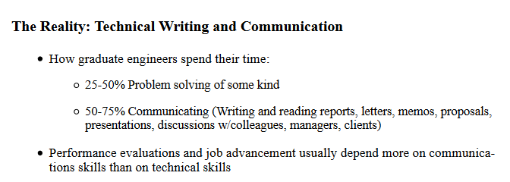
Importance of Reports (contd.)
Serves to evaluate the measure of the progress, or success of an organization
Helps to develop critical thinking and writing skills
Last, S. (2019)
Notes:
In a recent presentation on the topic of Co-op Work Term Reports, ^{[1]} the Engineering co-op coordinator for the University of Victoria presented the following statistics regarding the importance of communication skills in the professional world of engineering:
He added that engineers who are more advanced in their careers spend only 5-10% of their time engaged in problem solving of some kind and 90-95% of their time engaging in related communications tasks: researching, writing and reading reports, proposals, emails, letters, memos; giving or attending presentations; discussing and meeting with colleagues, team mates, managers, clients, and so forth. In a recent survey of over 1000 professionals from various professions, over 70% of engineers and almost 50% of programmers rated the quality of their writing as either “very important” or “extremely important” to the performance of their jobs.^{[2]} Clearly, as Barry Hyman asserts in Fundamentals of Engineering Design, “the stereotype that engineering is for inarticulate nerds is way off base.” ^{[3]}
Source: Last, S. (2019)

Slide 11
(Broad) Objectives of Reports
Variety of readers (d•
Variety of readers (different departments, competencies and specialisations)
ifferent departments, competencies and specialisations)
T•
Technical reports crafted by bearing in mind
echnical reports crafted by bearing in mind
A•
Accommodate readers desire to focus on specific parts of the report
ccommodate readers desire to focus on specific parts of the report
(Houp et al 2006. p. 232)
Notes:
Technical reports are crafted bearing in mind:
that it may be read by a variety of readers and
that report must accommodate busy readers who would want to focus on specific parts of the report. For this purpose reports are prepared in manner that the reader can easily navigate herself
Source: (Houp et al 2006. p. 232).

Slide 12
(Specific) Objectives of Reports
To present a record of accomplished work (Project work)
To record an experiment (primary research report/ lab report)
To record research findings or technical specifications (details of a new product)
To document schedules, timetables and milestones
To record and clarify complex information for future reference (policies and procedures)

Slide 13
(Specific) Objectives of Reports
To present information to a large number of people (annual report)
To present organized information on a particular topic (Working of divisions in an organization)
Recommend actions for solving certain problems (recommendatory report)

Slide 14
Characteristics of a Report
Precision
Factual details
Relevance
Reader- Oriented
Objectivity of recommendations
Simple and unambiguous language

Slide 15
Language Requisites
Clarity
Brevity
Grammatical accuracy

Slide 16
Format
Special format – cover , title, list of illustrations, letter of transmittal, and appendices
Illustrations – tables, graphs, maps, drawing, charts or photograph
Homogeneity - Deal with one topic at a time
Documentation – Acknowledge sources.

Slide 17
Page | Element
Cover | Title and image
2. Title Fly | Title only
3. Title Page | Label, report, features title, authors, affiliation, date, and sometimes for whom the report was prepared
4. Table of Contents | A list of the main parts of the report and their respective page numbers
5. Abstract | Informational abstract: highlight topic, methods, data, and results Descriptive abstract: (All of the above without statements of conclusion or recommendations)
6. Introduction | Introduces the topic of the report
7. Body | Background Methodology Results Analysis and Recommendations
8. Conclusion | Concise presentation of findings: This portion clearly indicates the main results and their relation to recommended action or outcome.
9. References | Bibliography or Works Cited
10. Appendix | Related supporting materials: This may include maps, analysis of soil samples, and field reports.
Notes:
Source: Adapted from OER Services (n.d.)

Slide 18
Types of Report
Informative, Analytical (purpose)
Periodic, special (frequency)
Oral, written (mode of presentation)
Long, short (length)
Formal, informal (approach)
Individual, group (target audience)
Notes:
The type of report depends on its function.
The function of the report is its essential purpose, often indicated in the thesis or purpose statement.
The function will also influence the types of visual content or visual aids, representing words, numbers, and their relationships to the central purpose in graphic, representational ways that are easy for the reader to understand.
Source: OER Services (n.d.)

Slide 19
Types of reports
Informative
Purpose
Analytical
Periodic
Frequency
Special
Mode of presentation
Oral
Written
Reports
Long
Length
Short
Formal
Approach
Informal
Individual
Audience
Group
Notes:
There are two main categories for reports, regardless of their specific function or type.
An informational report informs or instructs and presents details of events, activities, individuals, or conditions without analysis. An example of this type of “just the facts” report is a police accident report. The report will note the time, date, place, contributing factors like weather, and identification information for the drivers involved in an automobile accident. It does not establish fault or include judgmental statements. You should not see “Driver was falling down drunk” in a police accident report. Instead, you would see “Driver failed sobriety tests and breathalyzer test and was transported to the station for a blood sample.” The police officer is not a trained medical doctor and is therefore not licensed to make definitive diagnoses, but can collect and present relevant information that may contribute to that diagnosis.
The second type of report is called an analytical report. An analytical report presents information with a comprehensive analysis to solve problems, demonstrate relationships, or make recommendations. An example of this report may be a field report by a Center for Disease Control (CDC) physician from the site of an outbreak of the H1N1 virus, noting symptoms, disease progression, steps taken to arrest the spread of the disease, and to make recommendations on the treatment and quarantine of subjects.
Source: OER Services (n.d.)

Slide 20
Informative Reports
Contains only the data collected or the facts observed in an organized form
Does not contain any recommendations
Collect data , arrange it in an appropriate order and present it in a style appropriate to technical writing
Notes:
Descriptive writing is commonly used where you are asked to describe or outline the way things are (for example, the features of a particular theory) or the way things happened (for example, a series of historical events). Descriptive writing focuses on answering the ‘what?’ ‘when’ and ‘who’ type questions.
Descriptive writing simply lists or catalogues information. It does not establish relationships between the pieces of information and does not present a position to be argued.
Descriptive writing also typically allows you very little opportunity to show your voice, that is, your interpretation of the source material and your point of view.
Source: The Write Site (n.d.)

Slide 21
Analytical (interpretative/investigative) reports
Analyses the facts, draws conclusions, and makes recommendations
Drafting problem statement
Evolving criteria for analysis
Analysis of the data
Drawing conclusions and making recommendations
Notes:
Analytical reports show relationships between pieces of information. It is used to compare and contrast, assess or evaluate (for example, a number of approaches, theories, methodologies or outcomes).
It therefore has a structure based on the ordering of main ideas in relation to each other and uses evidence from various sources.
Analytical reports usually start with a brief description and then focus on answering questions like: ‘why?’ ‘how?’ and ‘so what?’
Analytical writing typically:
creates relationships between individual pieces of information by identifying main points and grouping information under these main points or conceptual categories.
creates its structure by ordering the main points or concepts in relation to one another.
often puts the identified concepts, at the beginning of the sentence, in theme position (Writers often place information in theme position as a way of maintaining the reader’s focus on a particular aspect of what they are writing about. Repeating the same or a similar theme in successive sentences helps to create and maintain cohesion in a written text).
uses comparative and contrastive language to express the relationships between different pieces of information, for example, comparative and contrastive conjunctions, adverbs and adjectives.
uses evidence from multiple sources to support assertions which are made.
does not identify and state a clear position – a thesis .
does not present clearly identifiable arguments in support of a thesis.
Another genre of analytical writing which can also be found in some analytical reports is called Persuasive Analytical Writing is a form of argumentative writing. This type of writing states a considered position and supports this position by presenting arguments and evidence from several sources. It uses a combination of organisational and linguistic elements to persuade the reader of the value of the approach you have taken to the question.
Persuasive analytical writing typically:
states a considered position on the basis of research and reading – a thesis.
supports this position by presenting arguments and evidence from multiple sources.
bases its structure on a perceived relationship between the individual arguments, and between the arguments and the thesis, and shows clear links between these elements.
develops conceptual categories and integrates and organises information under them.
uses evaluative vocabulary to signal the judgments the writer is making.
indicates the writer’s endorsement of or distance from the views presented by different sources.
Source: The Write Site (n.d.)

Slide 22
I M R a d Method
Analytical (Lab) reports use IMRaD method:
Introduction
Methods
Results and
Discussion
Conclusion and Recommendations(optional)

Slide 23
Periodic and Special Reports
Periodic or routine reports – prepared and presented at regular intervals – annually, semi-annually, quarterly, monthly, fortnightly
Either informational or analytical in their purpose
Example: Progress reports of various kinds : inspection reports, annual reports and sales reports
Special reports- related to a single occasion or situation

Slide 24
Oral and Written Reports
Benefits of Oral reports:
Immediate feedback
Audience response
Benefits of Written reports:
Permanent record
Accuracy

Slide 25
Long and Short Reports
Long reports – elaborate structure – has a format –after detailed research and data collection – contains illustrations
Short Reports – not elaborate – memo & letter reports

Slide 26
Formal and informal reports
Formal report – proper survey – prescribed format – language –formal – annual report, policy report, interpretive reports
Informal report - person to person – few lines to several pages – few people – Memo report

Slide 27
Individual and group reports
Report is classified based on the target audience:
Individual – employee’s progress report –(assessment/appraisal ) Manager – top authority
Group – from one department to another department – Marketing head sending sales report to Accounts department

Slide 28
Formats
Manuscript – Commonly used format for reports
Length can range from a few pages to several hundred
Can be used for informational or analytical
Abstract, summary, appendix and glossary

Slide 29
Memo and Letter reports
Memorandum or memo report: for internal communication within the organization
Used to handle routine business matters –passing information from one department to another – changes made within the organization
Permanent record of the internal operations of an organization
Letter Report: in the format of a letter.
All parts of a business letter except the inside address
Introduction, presenting facts, interpreting facts, and ending with a recommendation
Personalized form of report – more formal when moving upward

Slide 30
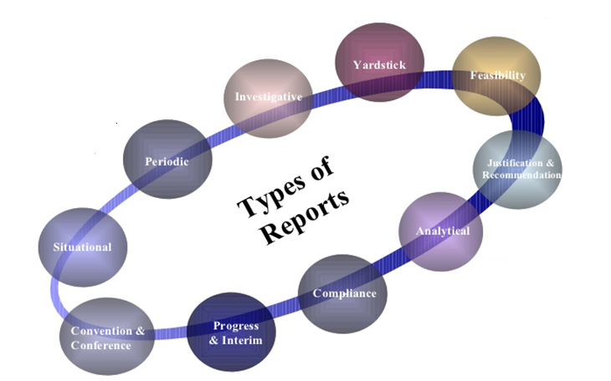
Typical Technical Reports: Specific Types

Slide 31
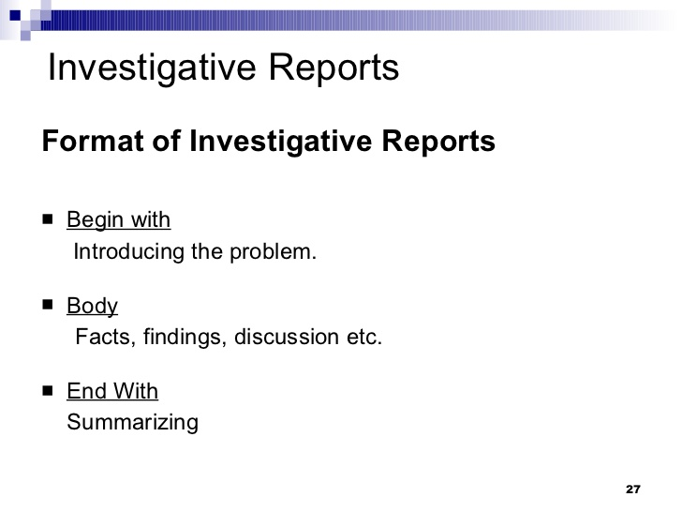

Slide 32
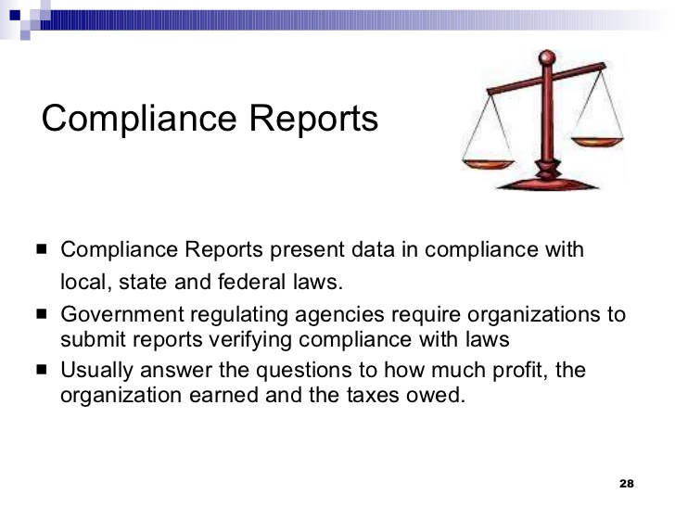

Slide 33
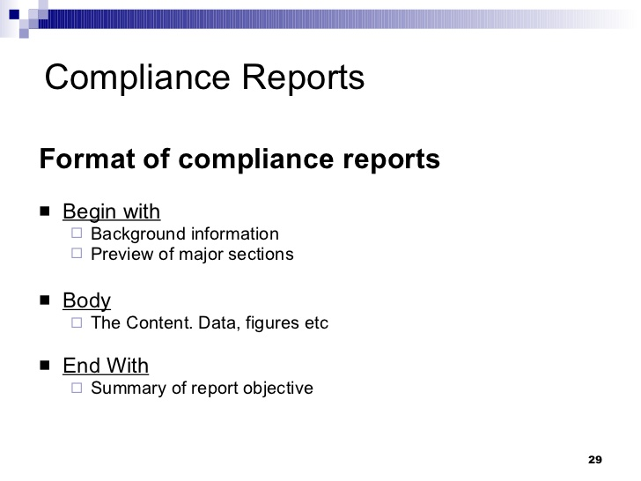

Slide 34
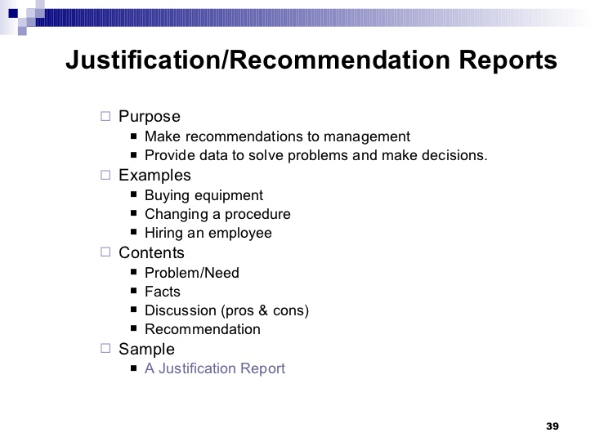

Slide 35
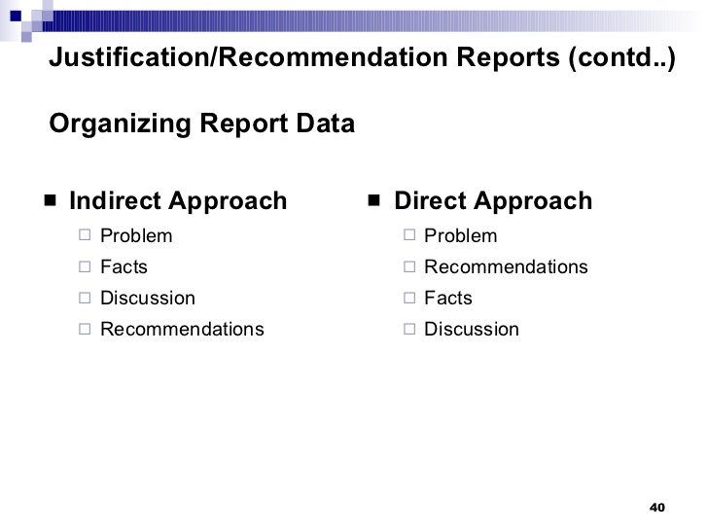

Slide 36
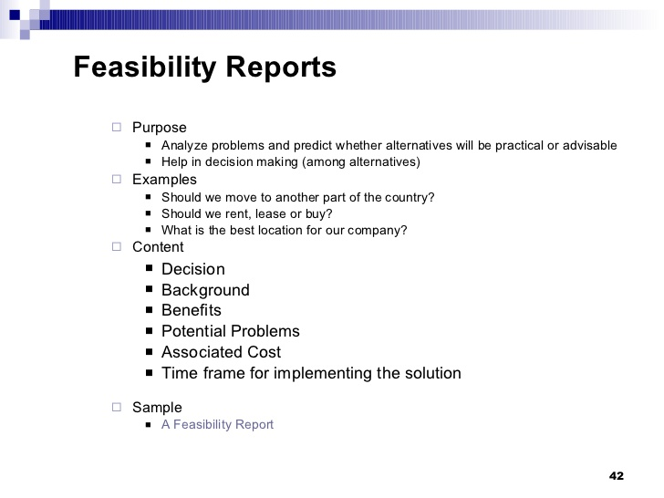

Slide 37
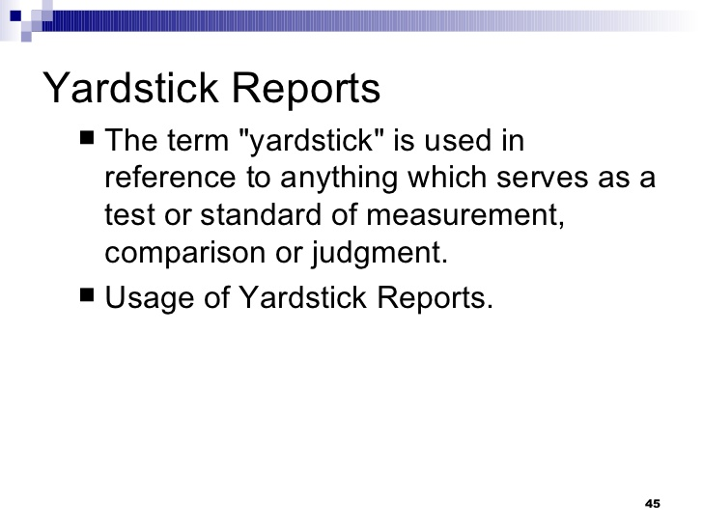

Slide 38
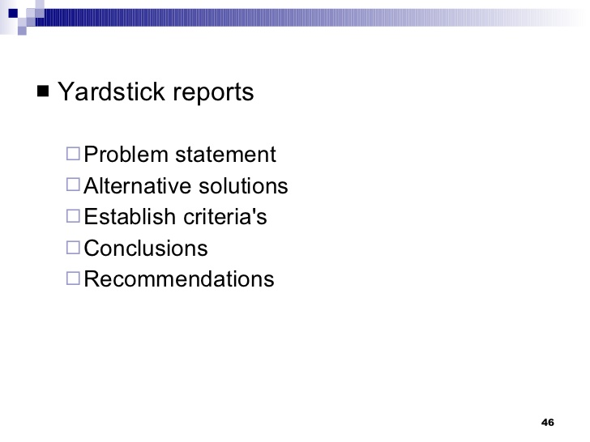

Problem Statement
Alternative Solutions
Establish Criteria
Conclusions
Recommendations

Slide 39

Research Reports/ Scientific Lab reports
Introduction
Methods
Results
Discussion
Conclusion

